Slide 1
A Comparative Study of Toxic Language Detection using NLP algorithm
Shivam Pandey RA1911003010383
Mayank Sinha ra1911003010386
guide name: Dr. g Ramya

Slide 2
Table of contents
ABSTRACT
PROBLEM STATEMENT AND OBJECTIVES
PROPOSED METHODOLOGY
BLOCK DIAGRM
IMPLEMENTATION
RESULTS
OUTPUT SCREENSHOTS
REFERENCES

Slide 3
ABSTRACT
As there are numerous algorithms utilised for toxic language detection in the field of natural language processing now, but they in this algorithm not developed considering production environment.
The speed of categorization has a significant impact on how quickly an application is used in a production setting where the algorithm is running in real-time.
The technique is only useful for theoretical applications if it performs classification tasks slowly. In the actual world, in this algorithm need algorithms that operates quickly and with excellent accuracy.
Through this research, in this algorithm hope to identify an algorithm that works best in the actual world, meaning that there is no compromise in this algorithm speed and accuracy.
For the classification job, in this algorithm will make use of the toxic language dataset. After classifiers have been trained, they will be put to the test using a variety of criteria, including accuracy, recall, precision, F1 score, and prediction time.
In this algorithm shall categorise the flaws in different NLP algorithms based on the parameters.

Slide 4
PROPOSED METHODOLOGY
We will be testing the algorithms in a real world environment, to validate whether these algorithms can solve real world problems when they are deployed in the production environment.
We trained the algorithms using sklearn python library on toxic language dataset.
We will compare their training time and then we will use the pickle module to save the model and then we will load the model in the backend of our app and then we will use the model to get predictions in the production environment and then we will check their prediction time and accuracy to understand their viability in solving real world problems.

Slide 5
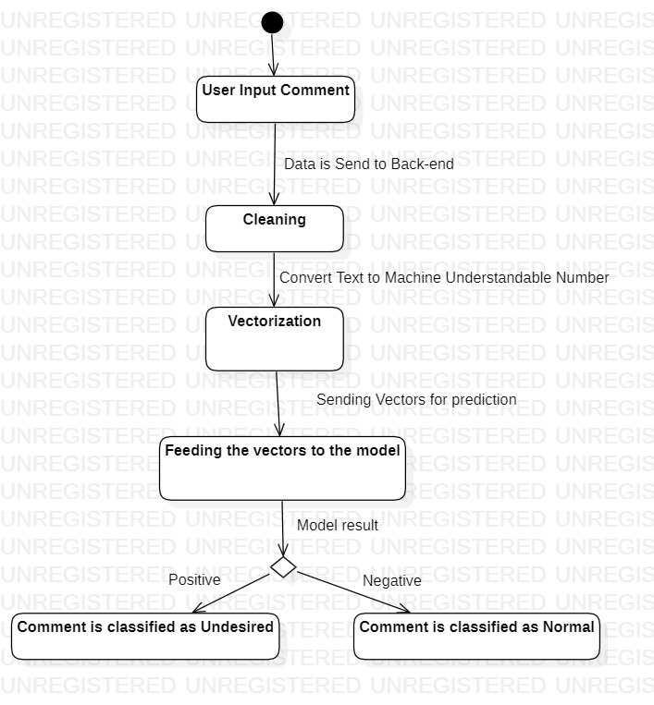
BLOCK DIAGRAM

Slide 6
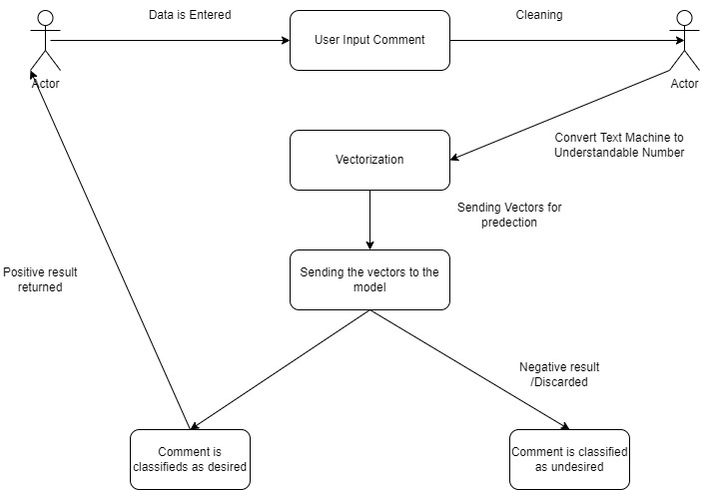
USECASE DIAGRAM

Slide 7
Implementation(100%)
We have created the project purely in python programming language.
We trained various Supervised Machine learning models using Sklearn library on toxic comment dataset, we compared their train time using time library.
We made our app using the streamlit library, which provides us with the functionality to easily create frontend for our ML app.
We deployed our app using the streamlit cloud feature and then we tested the time taken to give prediction of our app in the production environment.

Slide 8
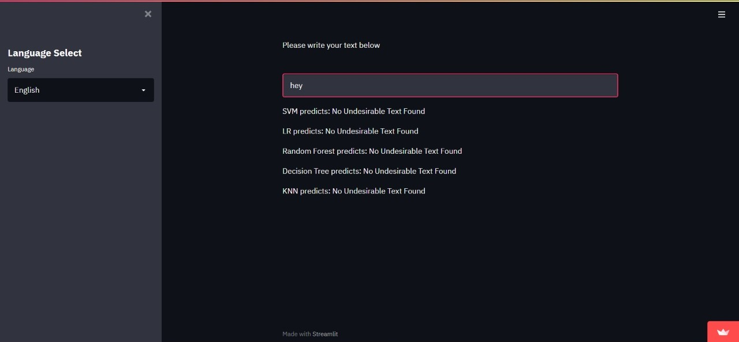
Working outputs

Slide 9
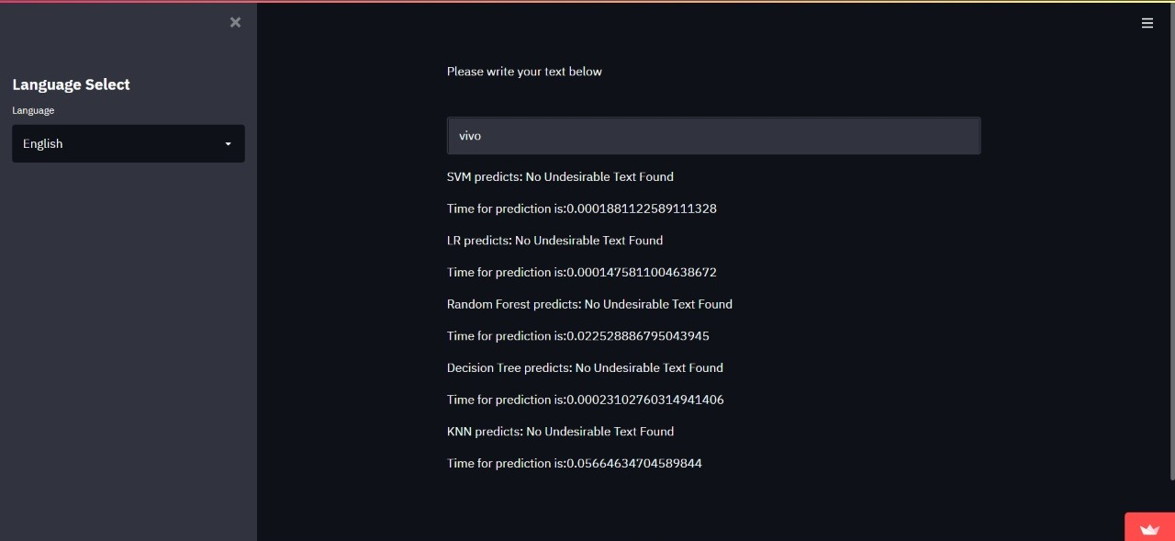
results

Slide 10
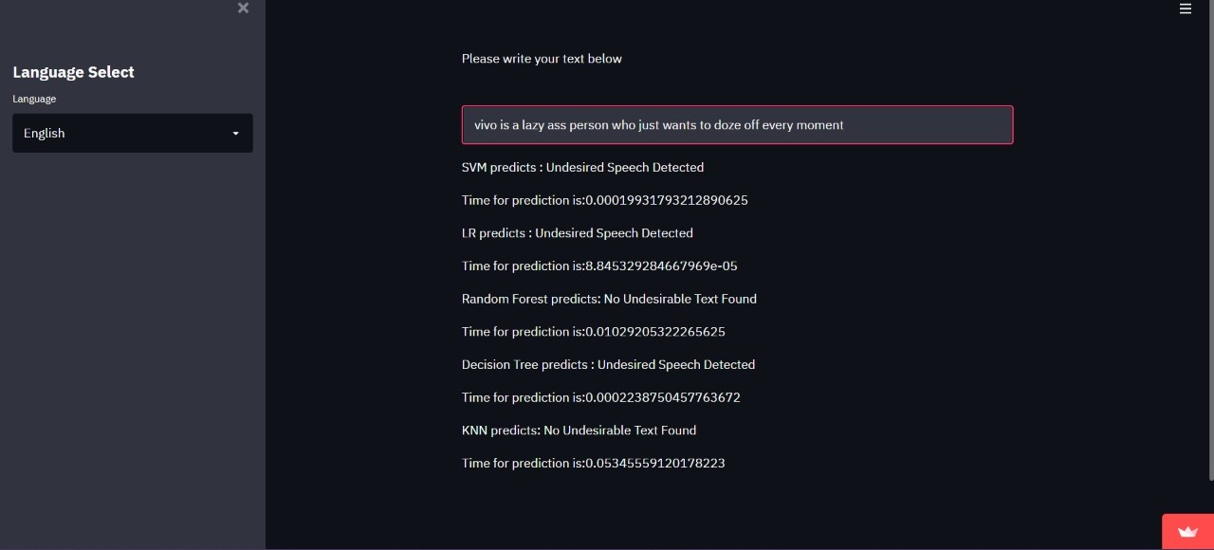
results

Slide 11
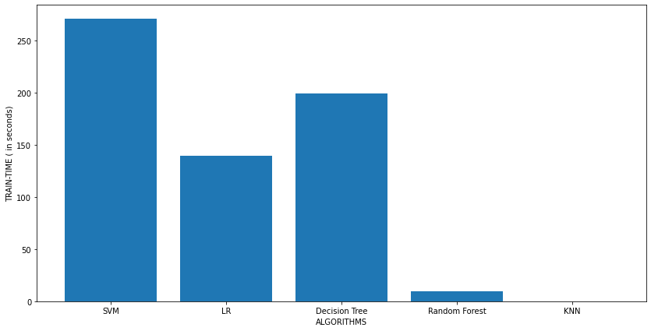
TRAIN TIME COMPARISON

Slide 12
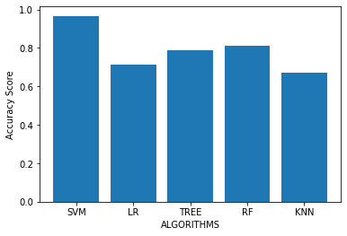
ACCURACY COMPARISON

Slide 13
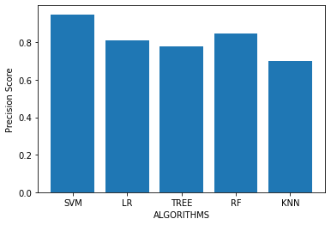
Precision COMPARISON

Slide 14
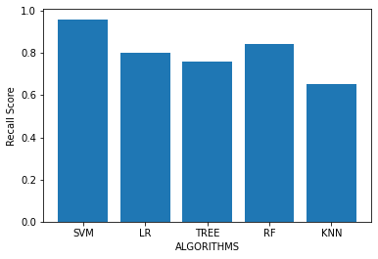
recall COMPARISON

Slide 15
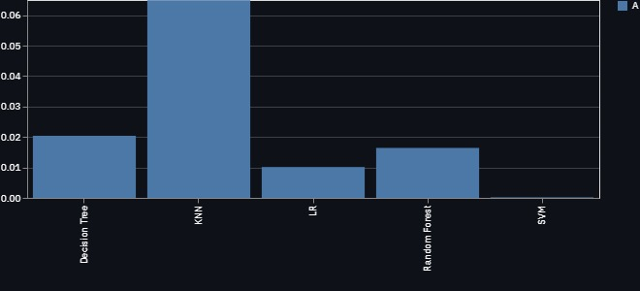
Prediction time in runtime environment
Prediction Time in seconds
ALGORITHMS

Slide 16
Output/discussion
Algorithms | Findings
KNN | Finding the right value of K is a tough task. Train time for this algorithm was the least. Prediction time was highest for this algorithm.
SVM | Train time was the highest for this algorithm. Prediction time was the lowest for this algorithm. Hyperparameter tuning was time taking .
Logistic Regression | The optimizer failed to converge even after 1000 epochs. Train time was high. Prediction time was pretty low.
Decision Tree | Hyperparameter tuning was very time taking. Training time was pretty low. Prediction time was pretty low.
Random Forest | Hyperparameter tuning took a very long time. Training this algorithm was very tough as the number of parameter was very high. The predictions given were highly inaccurate.

Slide 17
references
BAHDANAU D, CHO K,BENGIO Y ,A Neural Conversational Model,Google Research paper.
Jianfeng Gao, Michel Galley, Lihong Li, Neural approaches to conversational AI, Microsoft Research papers 2020.
Alec Radford, Jeffrey Wu,Rewon Child , Language models are unsupervised multitask learners, OpenAI research 2020.
Prasadhi Ranasinghe, Nipuni Chandimali, Chaman Wijesiriwardana, Systematic Exploration and Classiﬁcation of Useful Comments in Stack Overﬂow IEEE explore,2021
Aniket L Sulke1 Akash S Varude, Classification of Online Pernicious Comments using Machine ,MIT RESEARCH,2020
Qing Yu, Ziyin Wang and Kaiwen Jaing,Tianjin, Research on text classification based on BERT-BiGRU MODEL, researchGATE,2021,VOL2.
Kazi Saeed Alam, Cyberbullying Detection: An Ensemble Based Machine Learning Approach IEEE explore, 2020
Alee radford,karthik narasimhan,tim salimans,ilya sutskever,Improving language understanding by generative pre-training.ALBERT : a lite bert for self-supervised learning of language,IEEE explore,2021

